Slide 1
Mudano Assignment
Data Engineering

Slide 2
Extract data
Extracting the country data
from API using Response method in Python
Received Json output
Fetched all 6 pages (Json Array) and combined to one data frame
GDP data
Its available in CSV format
Downloaded the file and read using read_csv() from pandas

Slide 3
Transform Data
Converting Categorical variable to Numeric variable
Normalize the data
Dealing with missing value & filling them with appropriate value
Scaling the numeric value to the standard
Note: More transform can be done but due to time constrain preformed the important ones

Slide 4
Load Data
Understand the data and its dependencies. Used info() and describe() from pandas. Exported data to excel to do some analysis on it.
Created a data model which suites for the data
Determined the Primary Key, Foreign Key for each table
Loaded the data/ dataframes/ tables to SQL tables for further analysis or data science activities

Slide 5
Star Data model
Region
IncomeType
Region.ID
Region.value
IncomeType.ID
IncomeType.value
Country
ID
Latitude
Longitude
AdminRegion
LendingType
AdminRegion.ID
AdminRegion.value
lendingType.ID
lendingType.value

Slide 6
Question 1 to 6
Answers are provided in the below text document with the SQL queries used.

Slide 7
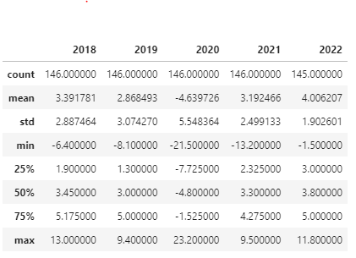
Question 7
Interesting fact about data:
From my perspective,
In GDP data, 2022 year is available which seems to be predicted
In 2019, there is some great fall and some great rise happened. Seems to be outliers.

Slide 8
Python File
Attached the python file here.
Thank You!

